Slide 1
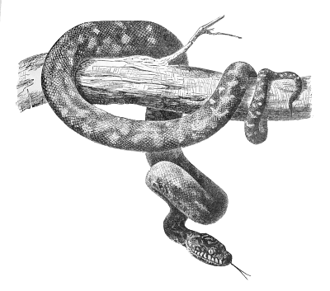
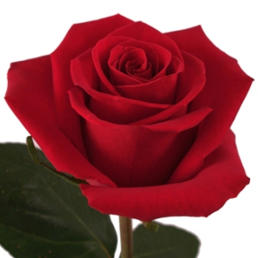
Symbolism

Slide 2
Symbolism in Literature
Literary device
“Applied to word or phrase that signifies an object or event, which in turn signifies something else or suggests a range of reference, beyond itself” (Abrams 320)
Helps relate seemingly unimportant aspects of the text to universal themes
Symbols fall into 2 categories:
“conventional/public”
“private/personal”
Notes:
Personal: We all have associations with things in our experience. One person may have strong affection for dogs while another person may fear them intensely.
Cultural: Different symbols may have quite different meanings in different cultures. A lion can represent Christ in Christian culture; in Sumerian culture, the sun represents the god Marduk. In Chinese culture, dogs represent devotion and faithfulness; in Islamic culture, they represent impurity.
Universal: Jungian psychology, along with other theories, argues that some symbols have universal meaning. Lions suggest deity in a variety of cultures, for instance. Trying to discern and express the universal meaning of a symbol is tricky.

Slide 3
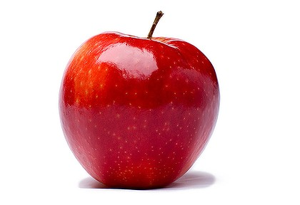
Conventional Symbols
Like all symbols, conventional symbols can include a setting, object, character, or event that has a literal (concrete) meaning and figurative (abstract) meaning
Terms that refer to symbolic objects where its other meaning is determined within its culture or accepted as universal
Symbol has a previously agreed upon meaning
Ex. Spring: birth, new beginning
Red: blood, passion, danger
Rain: sadness, despair
Notes:
In interpreting literature, it is important to remember that a poem or a short story means more than the writer consciously intended. It can have this surplus of meaning because of the way language works. Many images ("signs") in a work of literature will have personal, cultural, and universal associations for both reader and writer.
Neither writer nor reader is in control of these associations. We acquire the associations all through our life, and usually without being aware that we are acquiring them. When we speak, write, read, dream, or engage in any symbolic activity, these meanings are there naturally and unavoidably.
Thus, while a writer may intend to express certain meanings, the meaning he or she expresses will exceed what was consciously intended. Literature is rich and has lasting value because of its surplus meaning, the many layers of meaning it can convey to varied readers.

Slide 4
Conventional Symbol: Serpent
Literal Meaning: slithering reptile that hisses
Symbolic Meaning: the devil, especially the devil’s deceit and deception
Conventional Source: Genesis, the Garden of Eden

Slide 5
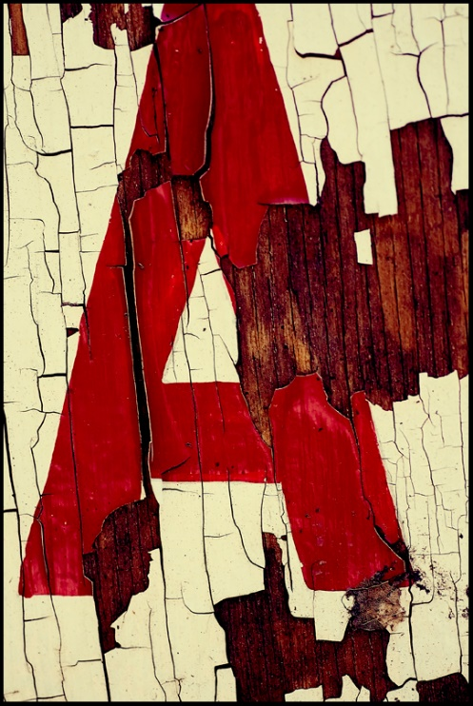
Personal Symbols
Using a symbol whose meaning the author generates on his or her own
Can become an emblem, an object whose significance is made determinate by its qualities and by the role it plays in the narrative
Personal symbols can become conventional symbols over time

Slide 6
Purpose of Symbols
Create meaning
Allude to feeling, mood, or attitude without directly stating the perspective or mood intended
Express a sentiment that can’t be conveyed through literal statements
Convey idea without having to explain it
Appeal to reader’s emotions and imagination
Notes:
Alluding to these elements is similar to real life because we automatically pick up on these signs

Slide 7
Identifying Symbols
Repeat appearance
Connection to character or event
Lengthier description

Slide 8
Symbol Example
Harry Potter’s Scar
- People identify him by his scar, representing being the chosen one
Gained the mark when Voldemort tried yet couldn’t defeat him, representing his ability to defeat evil and overcome impossible odds
It hurts him every time hatred is directed toward him (similar to Peter Parker’s spider-sense), representing his emotional sensitivity

Slide 9
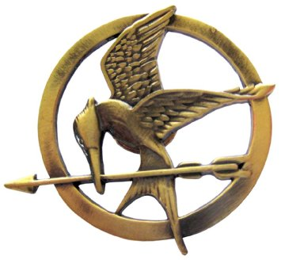
Symbol Example
Mockingjay
Pin given to her for good luck
“Barely cleared the review board” as an item that she can keep in the arena for fear of it being used as a weapon
A hybrid bird
Jabberjays are genetically engineered birds that were Capitol spies, but people started giving the birds false info
Mated with mockingbirds and offspring were able to repeat songs and melodies
Represents Katniss as hope for the districts, a spokesperson, someone able to trick the Capitol

Slide 10
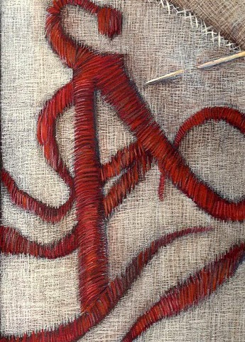
Symbolism in The Scarlet Letter
Determine the meaning of the following symbols – then, identify 2 more symbols in the text.
Prison
Rosebush
Pearl
Colors

